Slide 1
Synergy Review
Functional PLC programing for Processes

Slide 2
Let’s Review
1)Topics we covered already.
A) IEC 61131-3
B) Languages specified by IEC 61131-3
C) Basic Data Types
D) Variables and creating variables
E) If Statements
F) Some general syntax and general visualizations

Slide 3
IEC 61131-3
International standard that defines all aspects of industrial controls
- includes: definitions for languages, functions, communications
code reusability and language / device interoperability
Written and maintained by the OpenPLC coalition
Initially accepted by the IEC in 1994, updated in 2012.
Specifies control systems languages including
LAD
FBD
SFC
ST and
IL
Also defines Data Types that must be handled

Slide 4
Data Types
There are 2 categories of Data Types.
Primitives and Derivatives
Primitives are basic elements that the Engineering Software or the IEC standard has defined and are basic units of the IDE
Derivatives or Derived Data Units, are composed of primitives and often are combinations of primitives
Arrays
DUT Structures

Slide 5
What is a Bit?
IEC 61131-3 specifies data types that can be used for program structuring
Bits, or Binary data, often are represented or thought of as Discrete Inputs or outputs. These single digit units have only 2 states, on or off.
when programming these are often used to store Boolean values.
While Booleans have a high value of a single bit, they do in fact take up a byte in PLC memory **
** there is conflicting information in the Bedrock Slides about this however 8 bit Bools are fairly standard

Slide 6
Other Elemental Data Types
BOOL, BYTE, WORD, INT, TIME, TIME_OF_DAY
SINT, USINT, DINT, UDINT, LINT,

Slide 7
ST Syntax
Expressions and Instructions
Expressions are composed of operators and operands
Expressions return evaluations and set conditions
Conditions are evaluated with logical scrutiny to act via instructions

Slide 8
IF Then

Slide 9

So you went and joined fsociety
Your mom buy you that hacker hoodie?
You think you got chops? Prove it,

Slide 10
Get a Project File Up Homies
Make a heartbeat counter that increments by 1 every scan.
Make a reset for the heartbeat counter
Simulate your code, verify the reset works.
Hint: Counter variable should be a DINT
Reset variable should be a Bool

Slide 11
5 mins

Slide 12
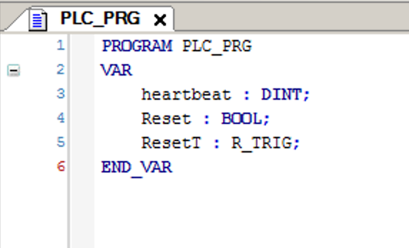
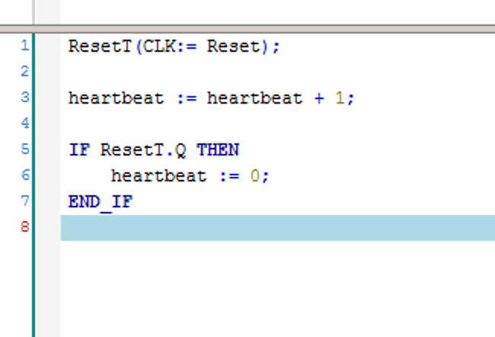
Variables
Code

